Slide 1
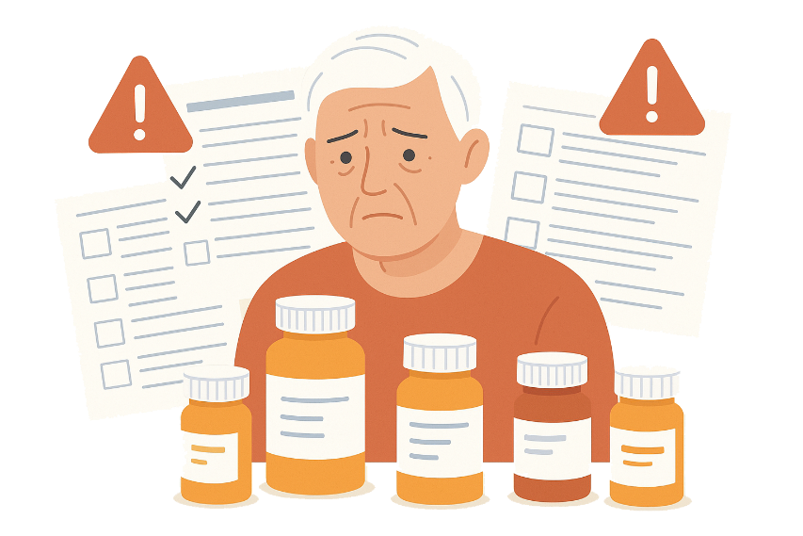



Improving Medication Safety in Older Adults: A Data-Driven Approach to Reducing Harm
Problem
Older adults often take 5+ medications = higher risk of interactions
Age-related changes in drug metabolism increase vulnerability
Care transitions (hospital discharge, clinic visits) lead to frequent medication discrepancies
Impact
1 in 3 older adults experience adverse drug events (ADEs) annually [1]
ADEs account for up to 30% of hospital admissions [1]
Economic burden: billions spent on preventable ADEs [1]
Previous Approaches
Pharmacist-conducted medication reviews
Electronic reminders and alerts
Limitations:
Work in silos, high clinician time dependency
ADEs often remain undetected until harm occurs [2]
Proposed Solution & Viability
Risk-Flagging Medication Intelligence System
Integrates pharmacy dispensing data,
Risk scoring for drug combinations and care transitions
Dashboard alerts for clinicians and pharmacists
Why it will work
Predictive risk models succeed in finance (fraud detection) & public health
Research support effectiveness of a flagging system [3]
Summary
Risk-Flagging Medication Intelligence System shifts from reactive correction to proactive risk identification
Reduce harm and hospitalizations
Improve provider workflow & older adult quality of life
Data-driven, collaborative approach targets preventable adverse events
Citation
Cosgrave N, Frydenlund J, Beirne F, et al. Hospital admissions due to adverse drug reactions and adverse drug events in older adults: a systematic review. Age Ageing. 2025;54(8):afaf231. doi:10.1093/ageing/afaf231
Parekh N, Ali K, Page A, Roper T, Rajkumar C. Incidence of medication-related harm in older adults after hospital discharge: a systematic review. J Am Geriatr Soc. 2018;66(9):1812-1822. doi:10.1111/jgs.15419
Ali K, Mensah EA, McDermott EA, et al. Implementation of a medicine management plan (Mmp) to reduce medication-related harm (Mrh) in older people post-hospital discharge: a randomised controlled trial. BMC Geriatrics. 2022;22(1):850. doi:10.1186/s12877-022-03555-w

